Slide 1

Bioinformatics
Dr. Md. Shamsuzzoha Bayzid
Department of Computer Science and Engineering Bangladesh University of Engineering and Technology

Slide 2
Distance-based Methods
Computing distance matrix
Computing a tree from a distance matrix

Slide 3
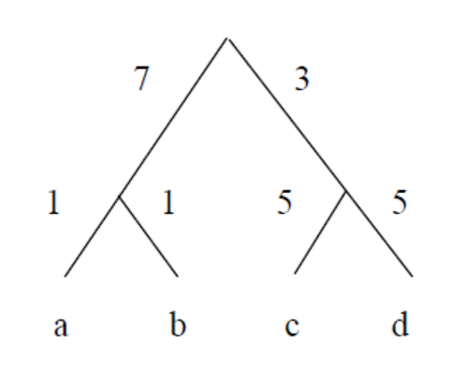
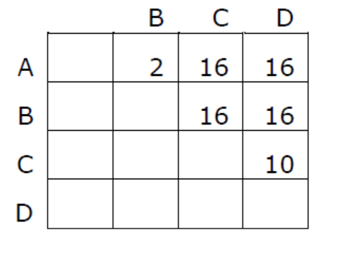
Distance Matrix

Slide 4
Distance Matrix
Additive and Ultrametric

Slide 5
Distance Matrix
Four point theorem

Slide 6

UPGMA
Unweighted Pair Group Method with Arithmetic Mean
Finds a pair of taxa x,y that have the smallest distance, and makes them siblings.
These two are then replaced by the cluster {x,y}
The distance from {x,y} to every other taxon z is defined to be the average of d(x,z) and d(y; z)
The process is repeated until all the taxa are merged into a single cluster

Slide 7
Example
Try yourself

Slide 8
UPGMA
May fail when the distance does not obey strict molecular clock (not ultrametric)
An ultrametric matrix is an n x n matrix M corresponding to distances between the leaves in a rooted edge-weighted tree T (with non-negative edge weights) where the sum of the edge weights in the path from the root to any leaf of T does not depend on the selected leaf.

Slide 9
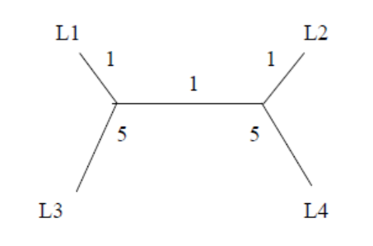
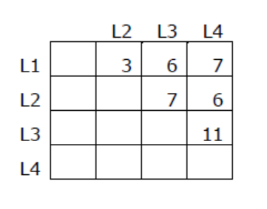
Example: UPGMA may fail!

Slide 10
Neighbor Joining
A distance based method with agglomerative clustering
Compute the Q function on the given distance matrix
Clustering is similar to UPGMA, but computing the distance from a clustered not to the others is different from UPGMA

